Slide 1
Voter model
10조

Slide 2
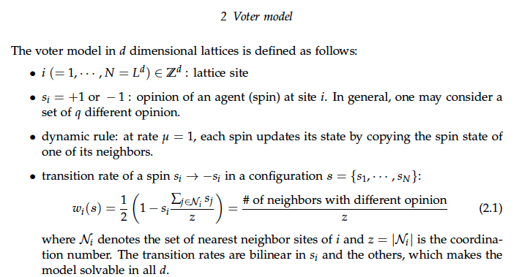

Voter model

Slide 3
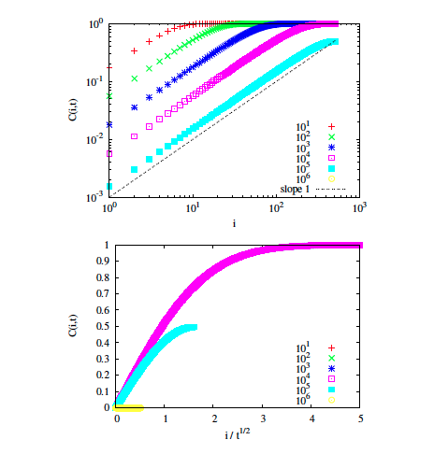
1D Voter model

Slide 4
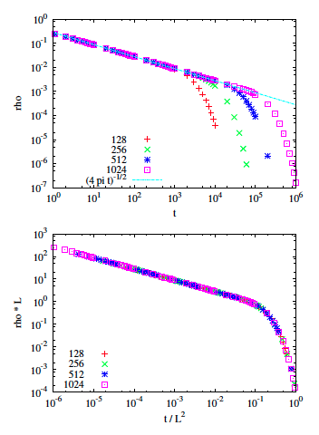
1D Voter model

Slide 5
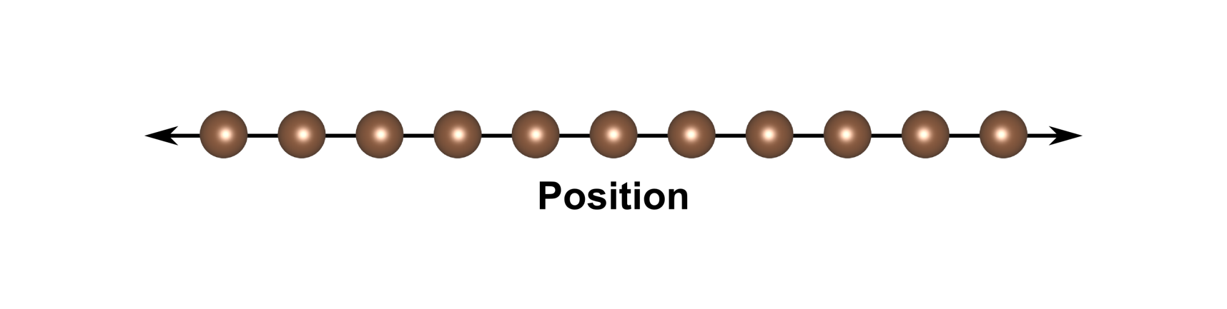




1D Voter model

Slide 6
Output

Slide 7
Output

